Slide 1
Implementing a Predictive Model
Technical Training Module
Arcadia Training Program

Slide 2
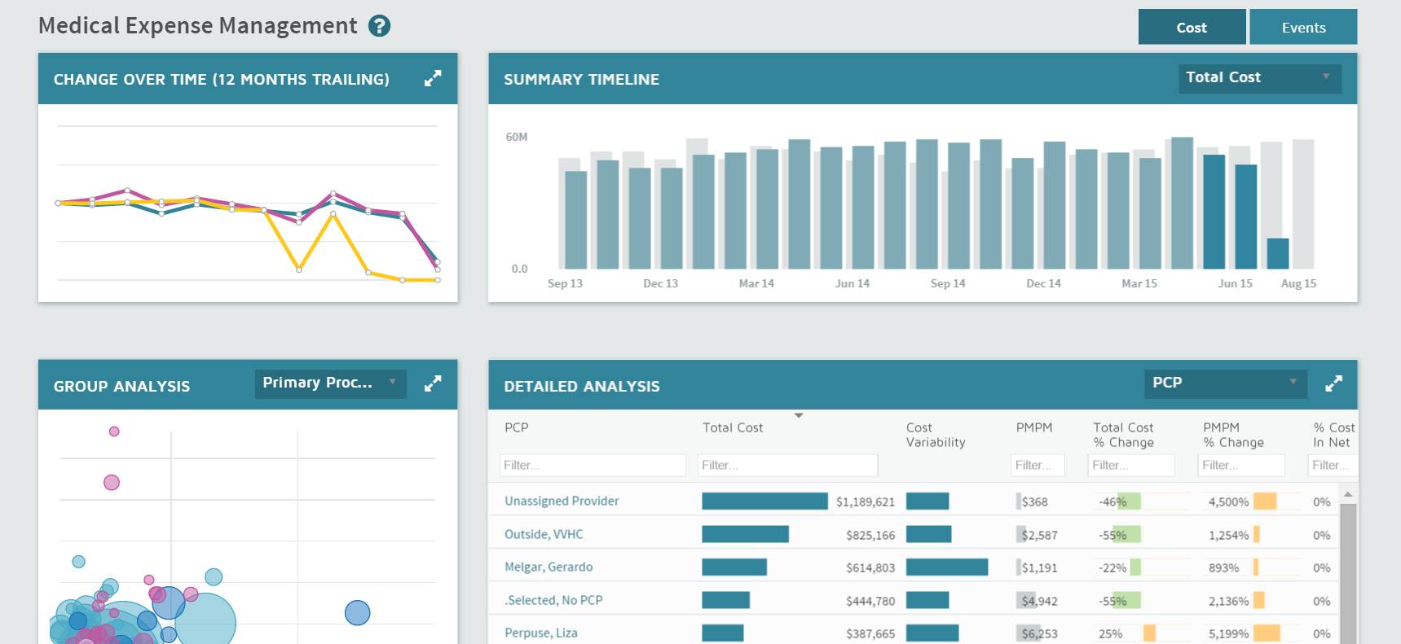
Progression in data analysis
Reporting
Analysis and Insight
Predictive Analytics
what happened?

Slide 3
Progression in data analysis
Reporting
Analysis and Insight
Predictive Analytics
what happened?
what does that mean?

Slide 4
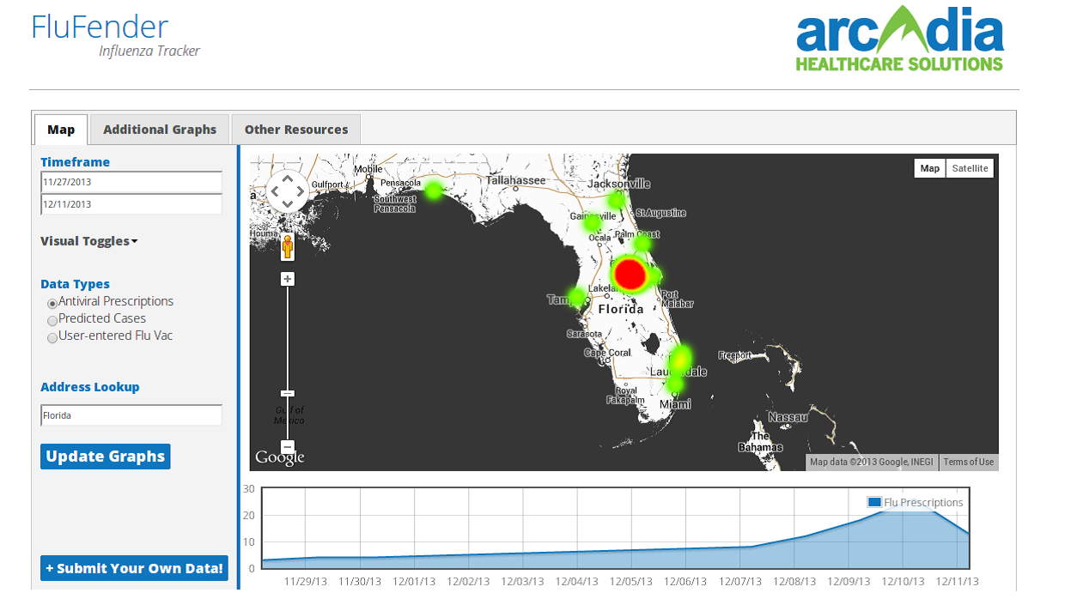
Progression in data analysis
Reporting
Analysis and Insight
Predictive Analytics
what happened?
what does that mean?
what will happen?!

Slide 5
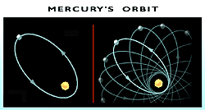

Some interesting application of predictive models
Einstein-Eddington Mercury orbit prediction
Darwin orchid moth prediction

Slide 6


Game Plan for implementing a predictive model
Start Here
Idea
Technique
MODEL
Validation
Data

Slide 7

Ideas and Questions
How can we generate relevant ideas? Ask interesting questions? Formulate hypotheses?
Internal Resources
External Resources
Fellow Arcadia data geeks
SMEs and data experts
Healthcare journals, tech blogs
Clients and customers

Slide 8
Technique
Once you finalize your idea the next step is to find the right modeling technique
Supervised Learning ●
Unsupervised Learning ●
Regression
Ex: Logistic regression
Decision Trees
Ex: Appointment model
Classification
Ex: Bayesian Classification
Neural networks
Clustering
Ex: K-Means
E-M Algorithm

Slide 9
Technique
Once you finalize your idea the next step is to find the right modeling technique
Supervised Learning ●
Unsupervised Learning ●
Regression
Decision Trees
Classification
Neural networks
Clustering
E-M Algorithm

Slide 10
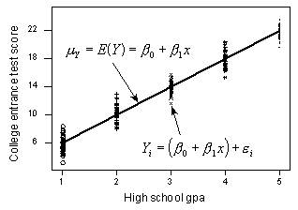
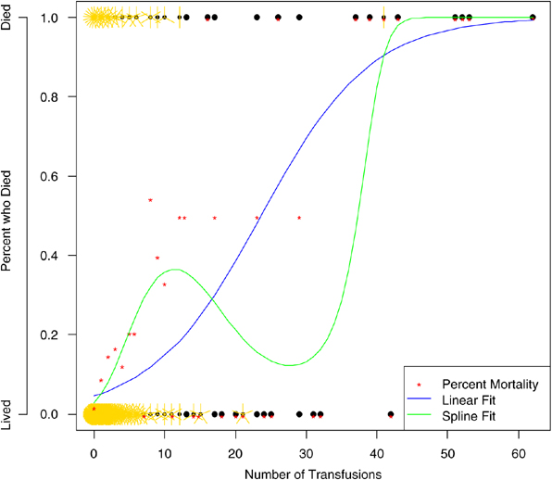
Technique
● Regression
Linear Regression
Logistic Regression

Slide 11
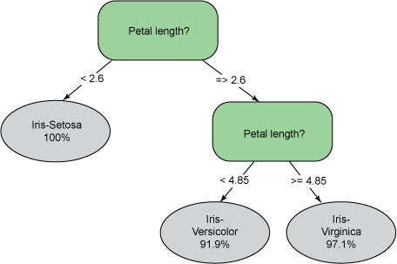
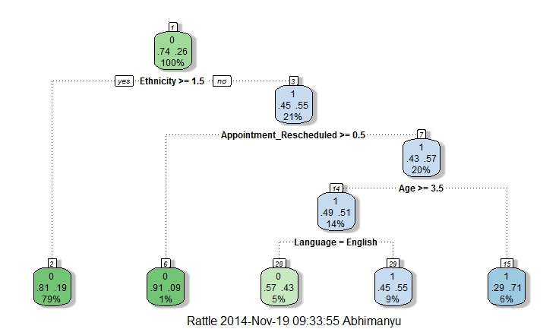
Technique
● Decision Trees
Regression Tree
Classification Tree

Slide 12
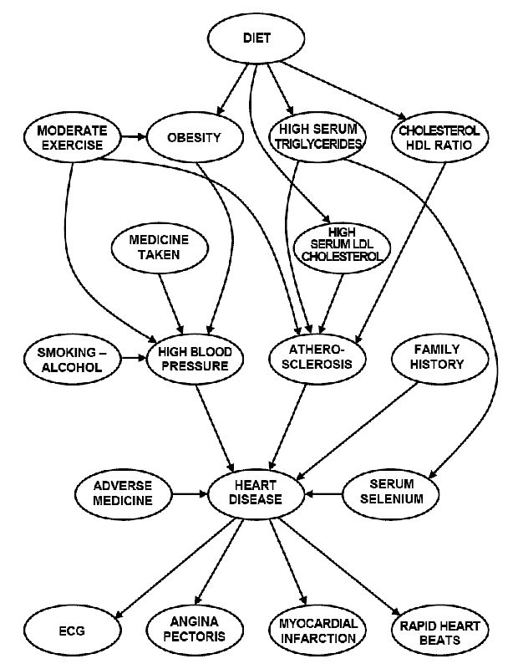
Technique
● Classification
Bayesian Classification

Slide 13
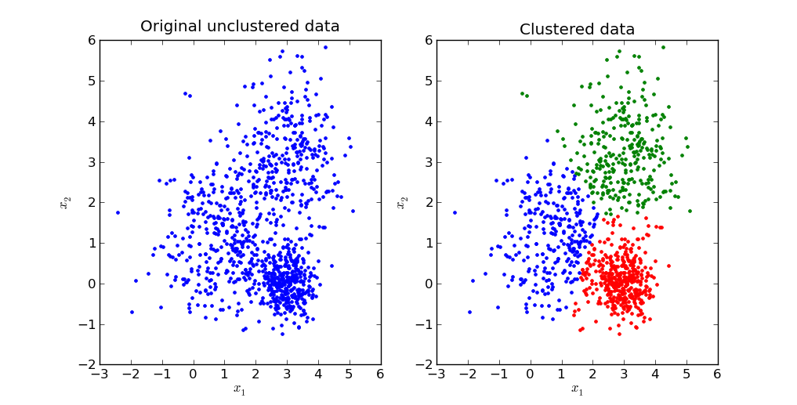
Technique
● Clustering
K-Means Clustering

Slide 14
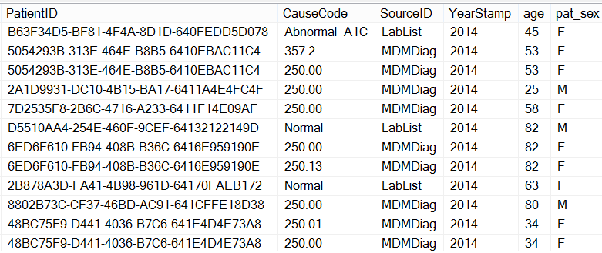
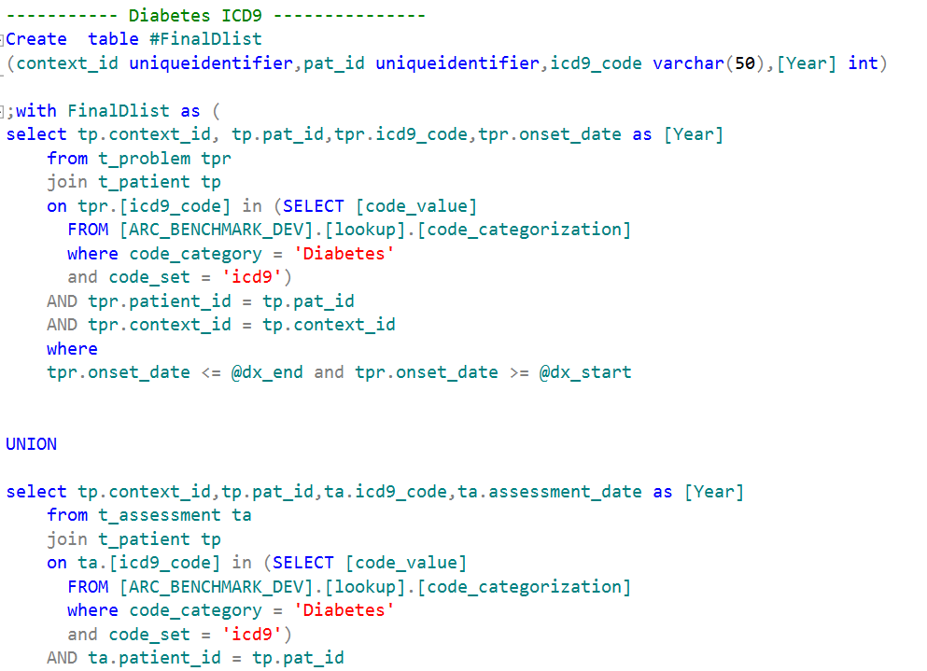
Data
Once you know the technique, gather the right data!
SQL
QDW

Slide 15
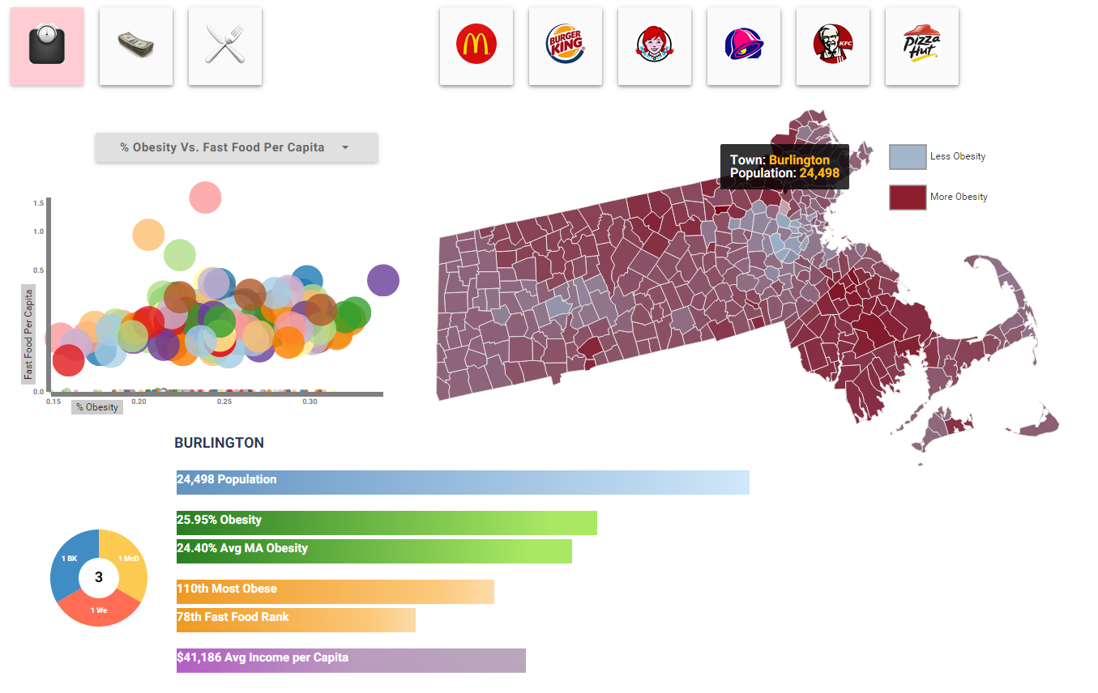
Data
External data is available to you as well
Awesome interactive visual by Simon Ioffe using fast food data per city, census data for income, and government data for obesity per county – combined with EHR obesity data

Slide 16
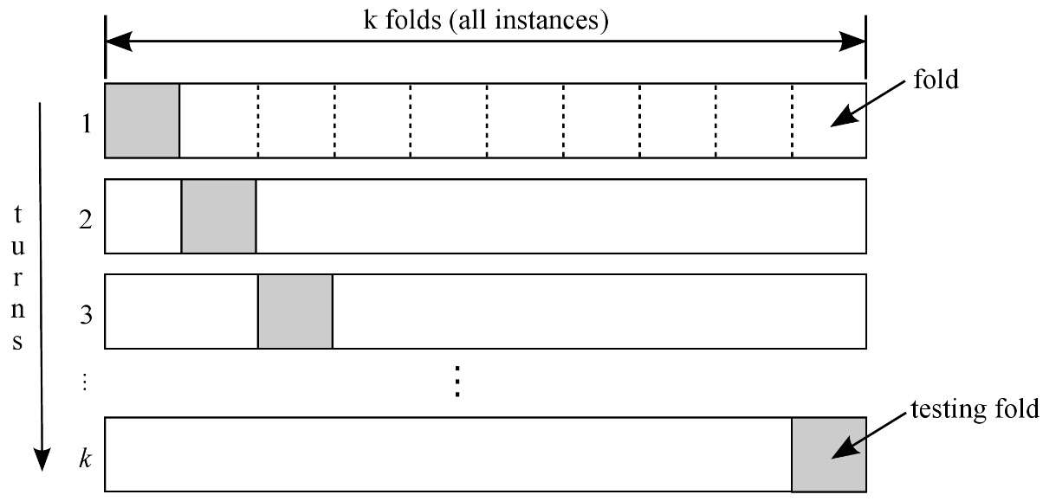
Validation
Model validation is a critical component
Model validation:
Retrospective validation
K-fold cross validation
Clinical SMEs
Internal resources
Data
Implement Model
Predicted Results
Actual Results

Slide 17
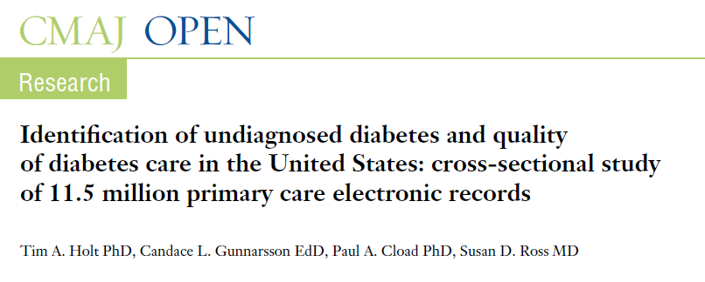
Implementing a predictive model
Building a Markov Model
Ideas! Questions!

Slide 18
Markov Model – What is it?
Back to basics: Markov Chain
A random process that undergoes transitions from one state to another
on a state space
Random Process
A series of events in which the outcomes cannot be conclusively determined
Note: random here does not mean arbitrary – just probabilistic
Transition
The movement from one state to another
Oftentimes associated with a probability (transition matrix)
State
A particular condition or value that can be taken on
Defining the state space is an important part of building a Markov model

Slide 19
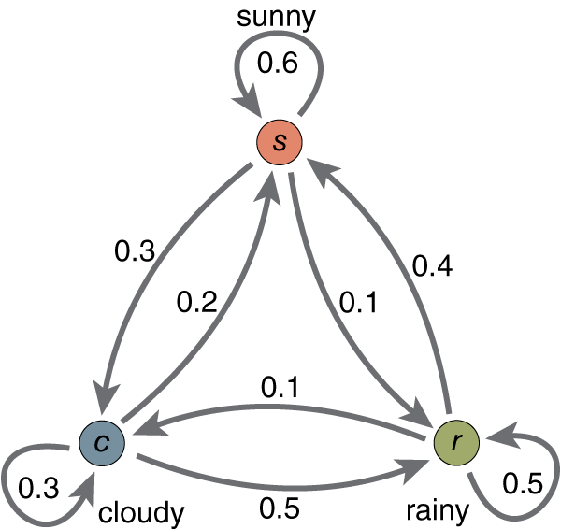

Markov Model – What is it?
Back to basics: Markov Chain
A random process that undergoes transitions from one state to another
on a state space

Slide 20

Markov Model – What is it?
Back to basics: Markov Chain
A random process that undergoes transitions from one state to another
on a state space

Slide 21
Hands On: Markov Modeling
Building a Markov Model
1) Pick your states
Let’s break down Diabetes into various conditions that are distinct and non-overlapping
Healthy
Prediabetes
Controlled Diabetes
Uncontrolled Diabetes
Healthy
Prediabetes
Controlled
Uncontrolled
Patients with no diagnosis of diabetes and no diabetes medication
Patients with a prediabetes diagnoses code
Patients with diabetes who have a normal A1c value
Patients with diabetes who have an abnormal (elevated) A1c value

Slide 22
Hands On: Markov Modeling
Building a Markov Model
1) Pick your states
Let’s break down Diabetes into various conditions that are distinct and non-overlapping
Healthy
Prediabetes
Controlled Diabetes
Uncontrolled Diabetes
Healthy
Prediabetes
Controlled
Uncontrolled
Patients with no diagnosis of diabetes and no diabetes medication
Patients with a prediabetes diagnoses code
Patients with diabetes who have a normal A1c value
Patients with diabetes who have an abnormal (elevated) A1c value
How do we determine which patients fall into these states?
Data

Slide 23
Hands On: Markov Modeling
Building a Markov Model
2) Define your transitions
How can a patient move between different stages of Diabetes?
Healthy patients can go anywhere
Controlled
Uncontrolled
Prediabetes
Healthy
Patients with no diagnosis of diabetes and no diabetes medication
Patients with a prediabetes diagnoses code
Patients with diabetes who have a normal A1c value
Patients with diabetes who have an abnormal (elevated) A1c value

Slide 24
Hands On: Markov Modeling
Building a Markov Model
2) Define your transitions
How can a patient move between different stages of Diabetes?
Prediabetes patients can go anywhere
Controlled
Uncontrolled
Prediabetes
Healthy
Patients with no diagnosis of diabetes and no diabetes medication
Patients with a prediabetes diagnoses code
Patients with diabetes who have a normal A1c value
Patients with diabetes who have an abnormal (elevated) A1c value

Slide 25
Hands On: Markov Modeling
Building a Markov Model
2) Define your transitions
How can a patient move between different stages of Diabetes?
Diabetes patients cannot become healthy
Controlled
Uncontrolled
Prediabetes
Healthy
Absorbing State
Patients with no diagnosis of diabetes and no diabetes medication
Patients with a prediabetes diagnoses code
Patients with diabetes who have a normal A1c value
Patients with diabetes who have an abnormal (elevated) A1c value

Slide 26
Hands On: Markov Modeling
Building a Markov Model
3) Look at the initial distribution
How are patients broken out by state in a given year?
Healthy
Prediabetes
Controlled
Uncontrolled
Patients with no diagnosis of diabetes and no diabetes medication
Patients with a prediabetes diagnoses code
Patients with diabetes who have a normal A1c value
Patients with diabetes who have an abnormal (elevated) A1c value
91.6%
0.4%
1.5%
6.5%

Slide 27
Hands On: Markov Modeling
Building a Markov Model
4) Now look at the transitions
How do patients transition from one state to another in a year?
2014
States | Healthy | PreDiabetes | Controlled | Not Controlled
Healthy | 20744 | 1708 | 351 | 304
PreDiabetes | 344 | 71 | 49 | 73
Controlled | 0 | 0 | 1141 | 712
Not Controlled | 0 | 0 | 1084 | 5657
2013

Slide 28
Hands On: Markov Modeling
Building a Markov Model
4) Now look at the transitions
How do patients transition from one state to another in a year?
2014
States | Healthy | PreDiabetes | Controlled | Not Controlled
Healthy | 20744 | 1708 | 351 | 304
PreDiabetes | 344 | 71 | 49 | 73
Controlled | 0 | 0 | 1141 | 712
Not Controlled | 0 | 0 | 1084 | 5657
2013
What does this number represent?

Slide 29
Hands On: Markov Modeling
Building a Markov Model
4) Now look at the transitions
How do patients transition from one state to another in a year?
2014
States | Healthy | PreDiabetes | Controlled | Not Controlled
Healthy | 20744 | 1708 | 351 | 304
PreDiabetes | 344 | 71 | 49 | 73
Controlled | 0 | 0 | 1141 | 712
Not Controlled | 0 | 0 | 1084 | 5657
2013
What does the sum of these represent?

Slide 30
Hands On: Markov Modeling
Building a Markov Model
4) Now look at the transitions
How do patients transition from one state to another in a year?
2014
States | Healthy | PreDiabetes | Controlled | Not Controlled
Healthy | 20744 | 1708 | 351 | 304
PreDiabetes | 344 | 71 | 49 | 73
Controlled | 0 | 0 | 1141 | 712
Not Controlled | 0 | 0 | 1084 | 5657
2013
What does the sum of these represent?

Slide 31
Hands On: Markov Modeling
Building a Markov Model
4) Now look at the transitions
A Transition Matrix
2014
States | Healthy | PreDiabetes | Controlled | Not Controlled
Healthy | 20744 | 1708 | 351 | 304
PreDiabetes | 344 | 71 | 49 | 73
Controlled | 0 | 0 | 1141 | 712
Not Controlled | 0 | 0 | 1084 | 5657
States | Healthy | PreDiabetes | Controlled | Not Controlled
Healthy | 90% | 7% | 2% | 1%
PreDiabetes | 13% | 64% | 9% | 14%
Controlled | 0% | 0% | 62% | 38%
Not Controlled | 0% | 0% | 16% | 84%
2013

Slide 32
Hands On: Markov Modeling
Building a Markov Model
4) Now look at the transitions
Transition Matrix meets State Diagram
0.62
0.38
0.84
Controlled
Uncontrolled
0.13
0.07
Prediabetes
0.16
0.09
Healthy
0.64
0.14
0.02
0.01
0.90

Slide 33
Hands On: Markov Modeling
Building a Markov Model
Okay…let’s make a prediction!
2014
States | Healthy | PreDiabetes | Controlled | Not Controlled
Healthy | 20744 | 1708 | 351 | 304
PreDiabetes | 344 | 71 | 49 | 73
Controlled | 0 | 0 | 1141 | 712
Not Controlled | 0 | 0 | 1084 | 5657
2013
21088 | 1779 | 2625 | 6746

Slide 34
Hands On: Markov Modeling
Building a Markov Model
Okay…let’s make a prediction!
21088
1779
2625
6746
90% | 7% | 2% | 1%
13% | 64% | 9% | 14%
0% | 0% | 62% | 38%
0% | 0% | 16% | 84%
initial distribution (2014)
transition matrix

Slide 35
Hands On: Markov Modeling
Building a Markov Model
Okay…let’s make a prediction!
21088
1779
2625
6746
90% | 7% | 2% | 1%
13% | 64% | 9% | 14%
0% | 0% | 62% | 38%
0% | 0% | 16% | 84%
initial distribution (2014)
transition matrix
How can we do this matrix multiplication? SQL is horrible with this. Let’s use..

Slide 36
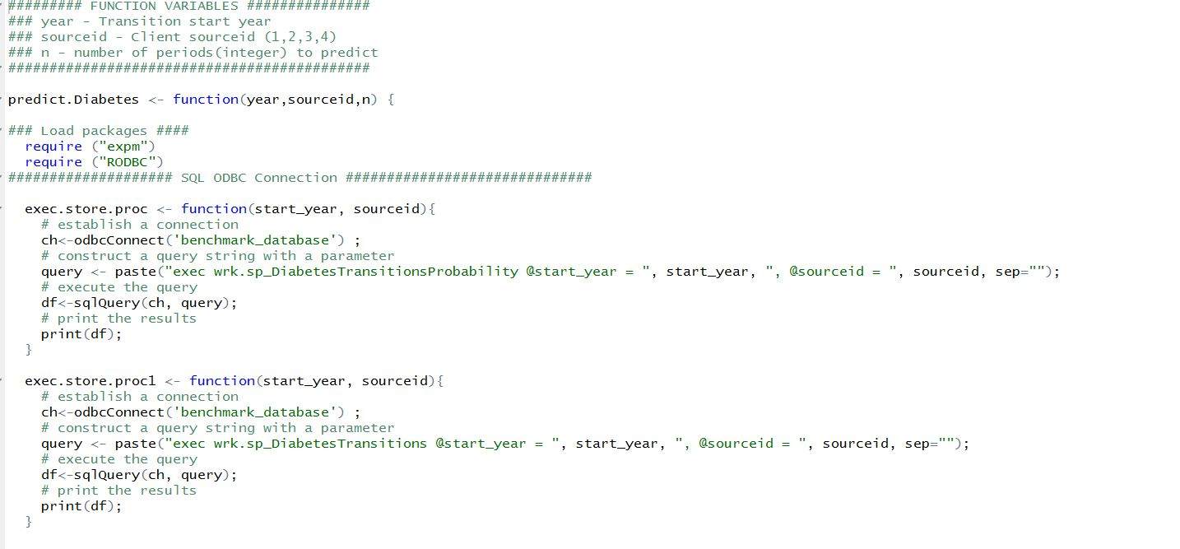
Markov Model - Prediction
R-script to predicting future state population

Slide 37
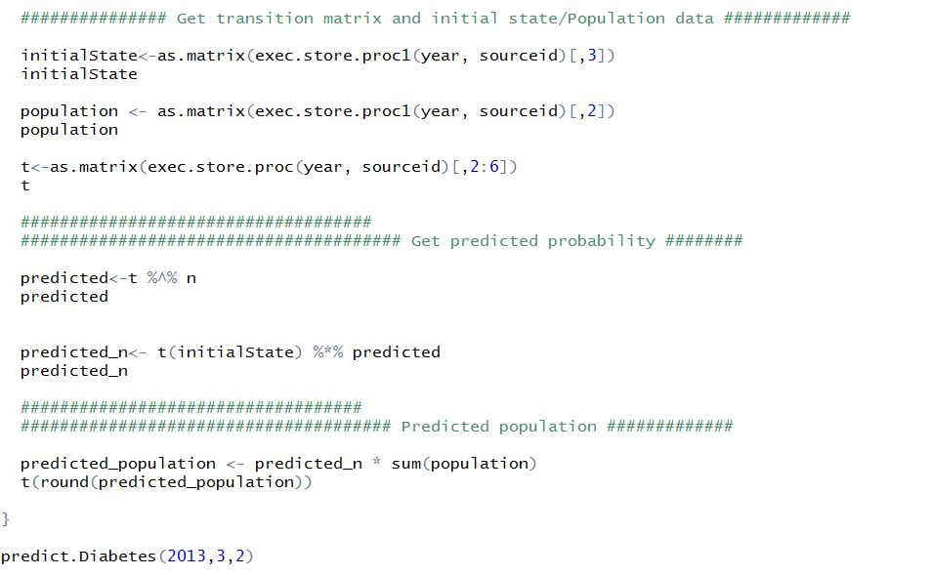
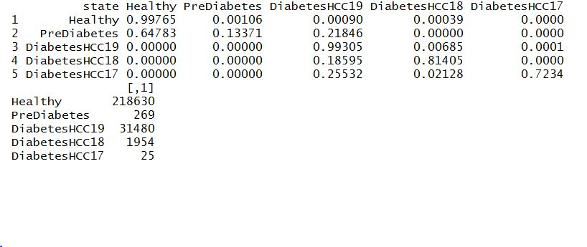
Markov Model - Prediction
R script

Slide 38
Markov Model - Results
Predicted Distribution
Patients broken out by state in the predicted year (2015)
Healthy
Prediabetes
Controlled
Uncontrolled
Patients with no diagnosis of diabetes and no diabetes medication
Patients with a prediabetes diagnoses code
Patients with diabetes who have a normal A1c value
Patients with diabetes who have an abnormal (elevated) A1c value
86.6%
0.1%
12.5%
0.8%

Slide 39
Markov Model - Validation
Retrospective Validation
Data
Initial population distribution for 2013
and transition matrix.
Implement Model
Implement Markov Model to predict
population distribution in 2014.
Predicted Results
Obtain predicted results for 2014.
Actual Results
Obtain actual distribution from retrospective
2014 data.

Slide 40
Markov Model - Importance
So what?
Helpful in predicting future diabetes state distribution, which could help in
resource planning and population health management.
Good exercise in implementing predictive models on healthcare data.
Demonstrate possible further applications in the predictive analytics domain.
Get everyone excited about predictive analytics.

Slide 41
Questions?

